Slide 1

LOBBYING EDUCATION: PART I
KATHLEEN Edwards
NC state ethics commission

Slide 2
OVERVIEW
-
STATUS: PROPOSED TRANSFER OF ETHICS COMMISSION TO BIPARTISAN STATE BOARD OF ELECTIONS AND ETHICS ENFORCEMENT (“BSBEEE”)
GENERAL OVERVIEW OF COMMISSION & ETHICS ACT
III. REQUESTING ADVICE
IV. GIFT BAN & GIFT BAN EXCEPTIONS
V. ADDITIONAL PROHIBITIONS & RESTRICTIONS APPLICABLE TO LOBBYISTS

Slide 3
ETHICS ACT--HISTORY
“The purpose of This Chapter Is To Ensure That Elected & appointed State agency officials exercise their authority
Honestly & Fairly,
Free from Impropriety, Threats, Favoritism, and Undue Influence.”

Slide 4
10 YEAR HISTORY-ETHICS COMMISSION
2006: Passage of Act
2007-2010: Refining
Commission Today

Slide 5
ETHICS/BSBEEE-COMPARISON
ETHICS COMMISSION
BSBEEE (In Litigation)
8 Members (4R, 4D)
4 by Governor (2D, 2R)
4 by Speaker/PPT (2D, 2R)
4 Year Terms
8 Members (4R, 4D) eff. 7/1/2017 (Current SEC Members 1/1/17 to 6/30/17)
4 by Governor (2D, 2R)
Selected from 3 nominees by Party
2 each by Speaker/PPT (1D, 1R)
Selected from 3 nominees by Majority & Minority Leaders
4 Year Terms

Slide 6
ETHICS/BSBEEE-COMPARISON
ETHICS COMMISSION
BSBEEE (In Litigation)
Executive Director Appointed by Board
Governor Names Board Chair Annually
Quorum = 5 Members
Simple Majority Vote Required
Quarterly Meetings Required
Acting Executive Director Serves Until New Board Appoints ED to 4-Year Term
Chair Selected by Board Annually
-D Member Serves Odd Years
-R Member Serves Even Years
Quorum = 6 Members
6+ Members Required
Monthly Meetings Required

Slide 7
ROLE OF THE ETHICS COMMISSION--ETHICS ACT
Financial Disclosure—Receive & Evaluate
Statements of Economic Interest
II. Educate Persons Subject to Act
III. Provide Advice to Persons Subject to Act
  Conflicts of Interest
  Acceptance of Gifts
  Use of Title in Advertising
IV. Receive and Investigate Complaints

Slide 8
ROLE OF THE ETHICS COMMISSION-LOBBYING LAW
Interpretation
Investigation
Issue Informal & Formal Advisory Opinions
Chapter 138B, Article 8 (former Chapter120C)
Investigate Alleged Violations of Lobbying Law, Including:
Gift Ban
“Cooling Off” Period
Misc. Restrictions
Adopt Rules Necessary to Interpret Article 8
Adopt Rules Necessary to Administer Part 2, 4, 5
Refer to Secretary of State:
Registration
Reporting
education
Conduct Lobbying Education & Newsletters

Slide 9
Informal Advice vs.
Formal Advisory Opinions
 | Informal Advice | Formal Advisory Opinion
Request | Written or Verbal | Must be Written
Advice | Issued by Staff | Issued by Commission
Confidential | Yes | Yes
Immunity | No | Yes
Redacted Advice Published | No | Yes Must Publish on Website in Edited Format.

Slide 10
GIFT BAN & GIFT BAN EXCEPTIONS
When & to Whom Does Gift Ban Apply?
What Are the Exceptions?

Slide 11
Gift Ban:
Unless There is an Exception
LOBBYISTS & LOBBYIST PRINCIPALS
Cannot Knowingly Give a Gift (Directly or Indirectly) To “Designated Individuals”
  Legislators
  Legislative Employees
  Public Servants
LIAISON PERSONNEL
Cannot Knowingly Give a Gift (Directly or Indirectly) To:
  Legislators
  Legislative Employees
“INTERESTED PERSONS”
Designated Individual Cannot Knowingly Accept Gift, (Directly or Indirectly), from:
    Interested Person
Gift Ban Applies 24/7/365

Slide 12



What is a “Gift”?
“Anything of Monetary Value”
Given Without Valuable Consideration
Gift Ban Applies to Direct and Indirect Gifts
No De Minimis Exception

Slide 13
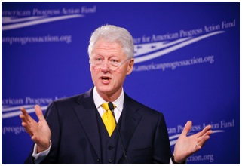
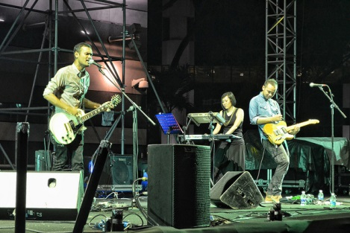

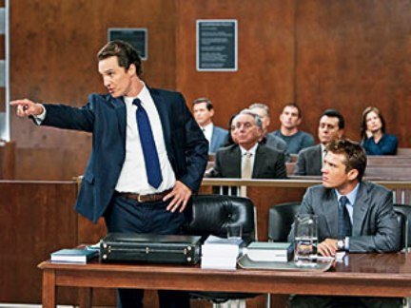
What is a “Gift”?
Entertainment
Professional Services

Slide 14

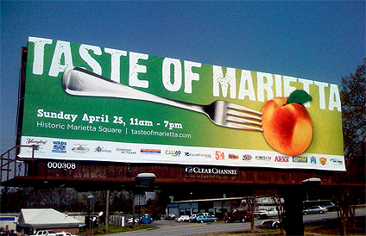
What is a “Gift”?
Gift Ban Applies Where A Designated Individual is the Ultimate Recipient
It Does Not Apply to Gifts to State Entities for Official Use
  Equipment
  Furniture
  Conference Space

Slide 15

What is NOT a “Gift”?
Paid Fair Market/Face Value
Loans With Same Terms As Commercially Available
Other Contractual or Commercial Arrangements
Items Reported Under Election Law
Expressions of Condolence
Cards, Letters, Notes, E-mails, etc.

Slide 16
“Indirect Gifts”
Restricted Donor May Not Give Gift
To An Intermediary, Including State
With the Intent That ANY Designated Individual
Be An Ultimate Recipient
(Unless Exception Applies)

Slide 17

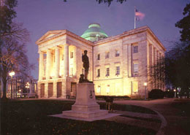
WHO ARE DESIGNATED INDIVIDUALS?
Legislative
Executive
“Public Servants”
Governor
Lt. Governor
Council of State
Cabinet Secretaries
Governor’s office employees
Policy-making positions, chief deputies, confidential assistants
Certain managerial positions
Others designated by Governor
Certain UNC System & community college officials & trustees; Board of Governors
Members of State Boards
Legislators
Legislative Employees

Slide 18
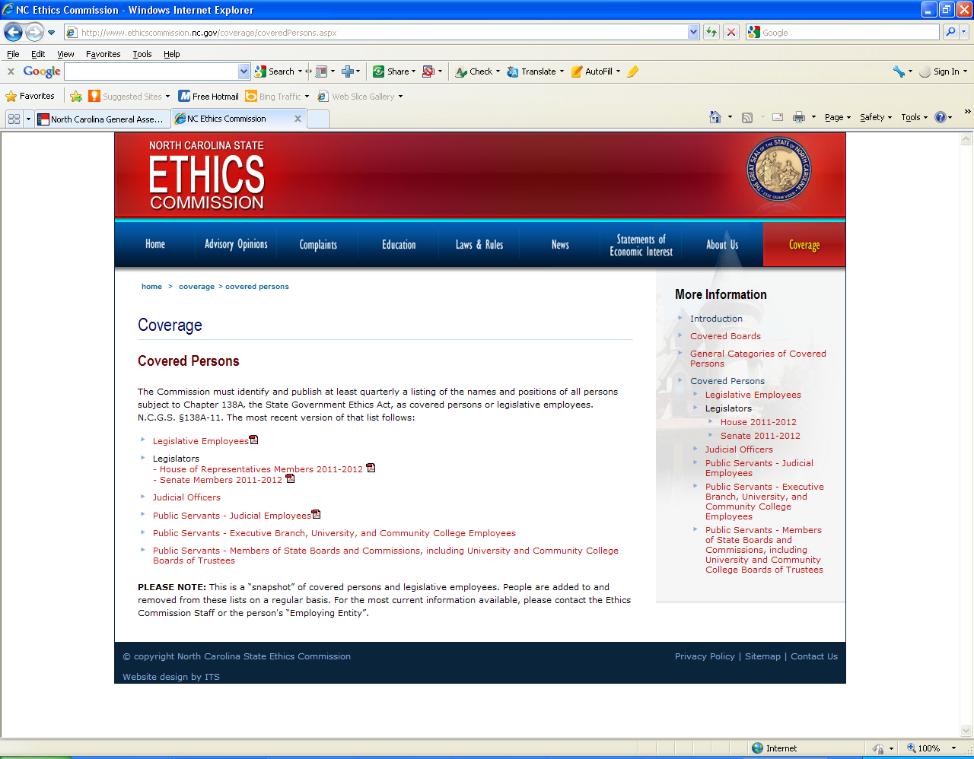
WHO ARE Designated Individuals?
List available on Commission’s website at www.ethicscommission.nc.gov
or by calling (919) 814-3600

Slide 19
GIFT BAN EXCEPTIONS **
N.C.G.S. §138A-32(e)
Food & Beverages for “Immediate Consumption”
Meeting & Conference expenses
Gifts to Non-Partisan Organizations
Informational Materials
Gifts to Family, Friends, Others
**Even if Allowed by Exception, May Still Be Reportable

Slide 20
Food & Beverages:
Open Meetings & Gatherings Open to Public
N.C.G.S. §138A-32(e)(1)
Food & Beverages for “Immediate Consumption”
Gathering Open to the
General Public
10 or more attendees
Sign or other Communication Outside Gathering Indicating Open to the Public
N.C.G.S. §138A-32(e)(1)b
Open Meeting of Public Body Properly noticed under the
Open Meetings Law
N.C.G.S. §138A-32(e)(1)a

Slide 21
Food & Beverages:
Specific Invitees
N.C.G.S.§138A-32(e)(1)c
Food & Beverages for Immediate Consumption
Invite “Qualifying
Group”
At Least 10 People Associated With Sponsor(s) Attend; or All Shareholders, Employees, Bd. Members, Officers, Members, Subscribers Located in NC are Invited.
All House or Senate members;
All Members of County or Municipal Legislative Delegation;
Recognized Caucus;
Committee/Commission of General Assembly;
All Legislative Employees; or
Public Servant’s Entire Board or at Least 10 Public Servants.
AND

Slide 22

Food & BeverageS: Invite
Written Notice by At Least One Sponsor to All Members Of At Least One of the Qualifying Groups (E-Mail Permitted)
Sent 24 Hours in Advance
Include Date, Time & Location of Event
Include Statement That “Gathering Permitted” Under Section

Slide 23
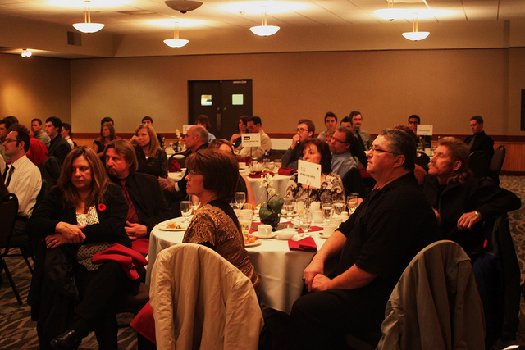
Food & Beverages
“Official Duty” for Public Servants
N.C.G.S. §138A-32(e)(12)
Food & Beverages for Immediate Consumption
Organized gathering where
  Public Servant’s Attendance is Primarily Related to Public Position and
  10 Individuals other than Public Servant or Immediate Family Attend or
  Certain Individuals connected with Sponsor(s) in Specific NC Office or County are Notified & Invited.

Slide 24
Meetings & Conferences
N.C.G.S. §138A-32(e)(3)(i)-(iv)
Lobbyist Principal (not Lobbyist or Interested Person)
Can Pay Reasonable Actual Expenditures for Food & Beverages, Travel, Registration, Lodging, Incidental Items of Nominal Value, Incidental Entertainment.
Categories of Meetings:
  “Educational” Meeting (primarily related to public duties; see 30 NCAC 07C .0101 );
  Designated Individual is a “bona fide speaker or panel member”;
  Attendance at Meeting of Nonpartisan Organization Where Agency is a Member or Designated Individual a Member Due to Public Position.

Slide 25
Meetings & Conferences
  Meeting has Formal Agenda, Notice Given at Least 10 Days in Advance, and Attended by at Least 10 Participants
  Food, Beverage, Transportation & Entertainment Must Be:
  Provided to All Attendees or Defined Groups of 10 or More; and,
  Part of or In Conjunction with Meeting
  Entertainment Must be Incidental to the Principal Agenda

Slide 26

WHAT IS AN “EDUCATIONAL” MEETING?
Commission-Adopted Criteria Considers:
The Type of Individual or Entity Hosting Meeting?
Primary Purpose to Influence Or to Promote Learning for Professional Improvement Notwithstanding a Particular
Executive or Legislative Action?
Is Lobbyist Principal Paying for Meeting Expenditures Also Hosting the Meeting?
Meeting Agenda/Length (Diverse Topics and Speakers, Full Agenda, Limited Entertainment and Meals)?
Location (Raleigh, NYC, Fiji)?

Slide 27

Meetings & Conferences
Reimbursable Expenses for Public Servants
N.C.G.S. §138A-32(f)
Applies ONLY to Public Servants & NOT legislators or legislative employees.
  Any Expense That Would Otherwise Be Reimbursable by the State if
  Public Servant Received Approval in Advance from Employing Entity to Accept the Expense on Behalf of the State
Actual Expense May Exceed State Rate
Notes:
27

Slide 28



Nonpartisan Agency Organizations:
Gifts Made Directly to Organization
N.C.G.S. §120C-303(d) and (e)
Both Direct and Indirect Gifts are Allowed if They Are:
Made by a Lobbyist or Lobbyist Principal Directly to
Nonpartisan State, Regional, National, or International Organization of which
Agency is a Member or
Designated Individual is a Member or Participant by Virtue of Public Position

Slide 29

Informational Materials
N.C.G.S. §138A-32(e)(2)
Informational Materials Relevant to Designated Individual’s Public Duties
  Books
  DVDs
  Magazines
  Newspapers

Slide 30

Family, friends, & others
Extended Family
N.C.G.S. §138A-32(e)(7)
Gifts to Extended Family Member
Still Subject to Reporting

Slide 31

Family, Friends & Others:
Other Relationships
N.C.G.S. §138A-32(e)(10)
Gifts based on Business, Civic, Religious, Fraternal, Personal, or Commercial Relationship Permitted if:
Relationship is Not Related to the DI’s Public Position and
Reasonable Person Would Conclude not Given for “Lobbying”

Slide 32
Plaques & Non-Monetary Mementos
N.C.G.S. §138A-32(e)(4)
A Plaque or Similar Non-Monetary Memento Recognizing Designated Individual’s Services in a Field or Specialty or to a Charitable Cause

Slide 33
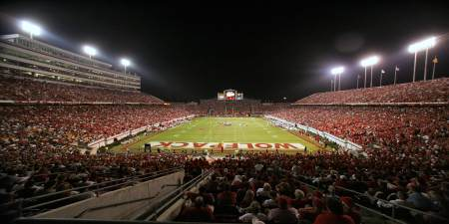
UNC system Athletic Tickets
N.C.G.S. §120C-501(e)
UNC Board of Governors, UNC Constituent Institutions, or their Legislative Liaisons
Cannot Give To Designated Individuals
For Lobbying (Direct Lobbying or Goodwill Lobbying)
GO WOLFPACK!

Slide 34
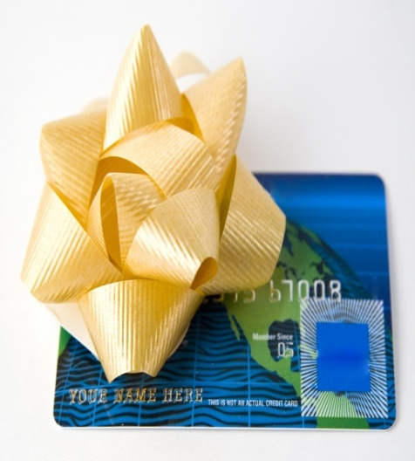
Honoraria
N.C.G.S. §138A-32(h)
Acceptance Restricted From All Donors
(Not Limited to L, LP, IP Donors)
If Legislator, Legislative Employee, Judicial Officer or Public Servant:
  Invited Because of Public Position
  Used State Resources or Reimbursed by State, or
  Used State Time
But, May Reimburse Agency for Expenses or Pay Fee

Slide 35
GIFT BAN REMINDERS
Gift Ban Applies at All Times
Commission May Designate other Boards and Commissions as Covered by the State Ethics Act
Check the Commission’s Website to Determine if Designated Individual = Covered by Gift Ban
Even if Allowed to Give, May Need to Report

Slide 36
OTHER REQUIREMENTS & RESTRICTIONS

Slide 37


Lobbying Law
Requirements & Restrictions
Lobbyist Must Identify Him/Herself as a Lobbyist and Disclose Identity of LP Prior to Any Lobbying Communication or Activity With DI
N.C.G.S. §120C-200(e)
Lobbyist Cannot Accept a Fee Contingent Upon the Outcome of Lobbying
N.C.G.S. §120C-300
  Exception for Sales People Whose Regular Remuneration Agreement Includes Commissions Based on Sales

Slide 38
Lobbying Law
Requirements & Restrictions
Lobbyist Cannot Serve as Campaign Treasurer or Assistant Campaign Treasurer for a Political Committee for Legislator or Constitutional Officer
N.C.G.S. §120C-304(d)
Lobbyist Restricted from Making Campaign Contributions to Legislative and Council of State Candidates
N.C.G.S. §163-278.13C (Interpreted by Board of Elections)
Lobbyist Cannot Allow a DI or a DI’s Immediate Family to Use Lobbyist’s Cash or Credit, Unless Lobbyist Present**
N.C.G.S. §120C-305
**But Don’t Forget Gift Ban

Slide 39
Lobbying Law
Requirements & Restrictions
Lobbyist Ineligible for Appointment To State Board Which has Regulatory Authority Over Entity Lobbyist Currently Represents or Has Within 120 Days after Lobbyist’s Registration Expired
N.C.G.S. §120C-304(e)

Slide 40
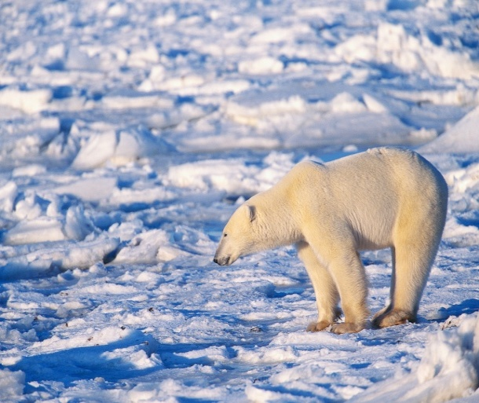
Lobbying Law
Requirements & Restrictions
“Cooling Off Period” N.C.G.S. §120C-304
The Following Cannot Be Lobbyists:
Legislator or Former Legislator
  While in Office; or
  Before the Later of:
    The Close of the Session (Sine Die) In Which the Legislator Served or
    Six Months After Leaving Office
Constitutional Officers and Heads of Principal State Departments
    While in Office or Employed, or
    Within 6 Months Thereafter

Slide 41

Lobbying Law
Requirements & Restrictions
“Cooling Off Period” N.C.G.S. §120C-304
  Former State Agency Employee Cannot Become
  A Lobbyist to Lobby That Agency
  Within Six Months After
    Voluntary Separation or
    Separation for Cause
If Former Employee Registers Within 6 Months of Separation, Must Identify Former Agency N.C.G.S. §120C-200(f)

Slide 42

Lobbying Education:
Part II
REGISTRATION, REPORTING, ENFORCEMENT

Slide 43

REGISTRATION
Who Must Register?
When Must Individuals Register?

Slide 44
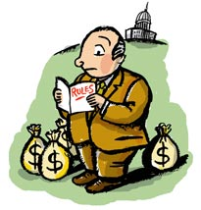
Who Must Register?
  Liaison Personnel
  Local Government Liaisons
  Lobbyists
  Lobbyist Principals
  Solicitors

Slide 45
Liaison Personnel Must Register
N.C.G.S. §120C-500, -501 and -502
    State Employee
    Local Government Employee
    Engaged in Lobbying Legislators or Legislative Employees
      NOT a “Lobbyist”
      “Cooling Off” Period Does Not Apply. AO-L-11-005
      State or Local Entity is NOT a Lobbyist Principal
      Liaison Must Register and Report Gifts, Reportable Expenditures
      Gift Ban Applies Only to Gifts from Liaison to Legislators and Legislative Employees

Slide 46
A “lobbyist” Must register
Who is a Lobbyist?
  Individual Who Engages in Lobbying
For Payment$$

Slide 47
What is “Lobbying?”
N.C.G.S. §120C-100(a)(9) a. and b.
“Direct” Lobbying
  Direct Communications or Activities
  With a Designated Individual or Designated Individual’s Immediate Family Member
    Designed to Influence “Legislative” or “Executive” Action
“Goodwill” Lobbying
    Developing Goodwill Through Communications and Activities, Including the Building of Relationships
    With a Designated Individual or Designated Individual’s Immediate Family Member
    With the Intention of Influencing Current or Future
    “Legislative” or “Executive” Action

Slide 48
Designed to Influence “Legislative Action”
N.C.G.S. §120C-100(a)(5)
Legislative Action:
Steps in the Legislative Process Taken by a Legislator or Legislative Employee:
  Preparation – Introduction – Consideration – Passage or Rejection of
  Bill – Resolution – Amendment – Motion
Also Includes Consideration of any Bill by the Governor for Approval or Veto

Slide 49
Designed to Influence Executive Action
N.C.G.S. §120C-100(a)(3)
Executive Action:
Official Actions Taken by a Public Servant
  Consider – Prepare – Approve – Postpone – Reject
  Policy – Procedure – Guideline – Rule – RFP –Invitation for Bid

Slide 50
NOT “Executive Action”
N.C.G.S.§ 120C-100(a)(3)a.-b.
Actions Exempt from Definition of Executive Action Include:
150B Contested Case Proceedings
Applying for a Permit, License, Determination of Eligibility, or Certification
Inquiring about a Benefit, Claim, Right, Obligation, Duty, Entitlement, Payment, or Penalty
Inquiring About or Responding to an RFP Under Ch. 143
Ratemaking

Slide 51

What is “Payment?”
Firm-Employed Lobbyist – Employed by a Firm and Lobbies for Entity or Individual That Hired Firm N.C.G.S. §120C-100(a)(10)b.
Contract Lobbyist – Contracts With Lobbyist Principal for Payment for Lobbying
N.C.G.S. §120C-100(a)(10)c.

Slide 52
What is payment?
Employee Lobbyist – Employee And a “Significant Part” of Duties Include Lobbying
  Significant Part = Employee’s Actual Duties Include Either
    5% or More of Direct Lobbying in any 30-Day Period
    5% or More of Goodwill Lobbying in any 30-Day Period

Slide 53
Persons Exempted
N.C.G.S. § 120C-700
Expressing A Personal Opinion & Not A “Lobbyist”
By Invitation of Member of Committee or Board, No Further Lobbying Activities
Person Responding to Inquiries from a Designated Individual, No Further Lobbying Activities
Governmental Officials & Employees When Acting Solely in Connection with Matters Pertaining to Their Public Duties (Not Liaison)
Designated Individuals Acting in Their Official Capacity
Persons Performing Professional Services in Drafting Bills or Advising on Effect of Official Action, Services Not Connected to Legislative Action
Political Committee as defined in N.C.G.S. §163-278.6(14)

Slide 54
Solicitation of others
N.C.G.S. §120C-215
Person not Otherwise Required to Register and Report Must Register & Report When
  Total Expenses for “Solicitation of Others”
  Exceeds $3,000 During any 90-Day Period
  Excludes
  Any Communication Made to the Person’s Stockholders, Employees, Board Members, Officers, Members, Subscribers
  Communications with Those Who Have Agreed to Receive Regular Publications or Notices

Slide 55
“Solicitation of Others”
N.C.G.S. §120C-101(a)(13)
  What Is Solicitation of Others?
  Request That Members of the Public
  Communicate With Designated Individuals
  For purpose of:
    Influencing Legislative or Executive Action
    To Further Solicitor’s Position
    Includes:
      Broadcasts (T.V. and Radio)
      E-Mail, Telephone, Letter
      Website Posting
      Print Media
      Conference or Meeting
Broadcast, cable, satellite E-mail or website posting Communication through print media | Mailing Telephone Communication at conference or meeting

Slide 56
WHAT MUST BE REPORTED?
  Reporting of Gifts
  Reporting of Other Reportable Expenditures for Lobbying
  Reporting of Payments for Services

Slide 57
What Does A Lobbyist Principal Report?
N.C.G.S. §120C-403(b), (c), (d), (e)
  Lobbyist Principal Reports What the Principal Paid for (Including Items for which Lobbyist was Reimbursed):
    “Reportable Expenditures” for Gifts Over $10 in Value to DI/Immediate Family Per Day
  Other “Reportable Expenditures” Made for Lobbying Over $10 in Value Per DI/Immediate Family Per Day
  “Solicitation of Others” Expenditures in Excess of $3,000
  Payments to Lobbyists for Lobbying and for Certain Communications and Activities Used to Lobby
  Name of Each Person or Governmental Unit to Whom the Lobbyist Principal “Loaned” its Lobbyist

Slide 58


What Does A Lobbyist Principal Report?
N.C.G.S. §120C-400(b)
  Do Not Need to Report Following Items Given to A State Agency as Long as Agency Maintains Public Record of Item:
    Cash
    Fixed Asset

Slide 59
WHAT REPORTABLE EXPENDITURES MUST BE REPORTED? N.C.G.S. §120C-403(b)
Gifts Given to a DI by a Lobbyist, Lobbyist Principal, or a Liaison With Value Greater than $10 per DI per Calendar Day
  LP “(e)(10)” Gifts are Not Required to Be Reported Until the Value is Greater than $200
Expenditures Greater Than $10/Day That Are Not Gifts But Are Made for Lobbying
  Made at the Request of or On Behalf of DI
  or DI’s Immediate Family Or
  Made for the Benefit of Immediate Family

Slide 60
WHAT REPORTABLE EXPENDITURES MUST BE REPORTED?
Other Expenditures That Are Made for Lobbying
Overhead Expenses Connected with Events Held for Lobbying 30 NCAC 10C.0302
  Planning and Organizing Services
  Outside Printing Services
  Facility Rental
  Name Badges
  Flowers and other Decorations

Slide 61
WHAT REPORTABLE EXPENDITURES MUST BE REPORTED?
Do Not Report Expenditures That Were “Promptly Paid for or Returned” by DI. N.C.G.S. 120C-401(i)
If Already Reported, Report Return or Repayment on Next Report Due
Designated Individual or Immediate Family Also Has Option of Reporting that Item was Paid for, Returned, or Donated to Charity. N.C.G.S. 120C-401(j)

Slide 62
REPORT DETAILS
N.C.G.S. §120C-401(b) and §120-401(c)
For Each Reportable Expenditure Must Include:
  Fair Market Value or Face Value of Expenditure
  The Date of the Expenditure
  A Description of the Expenditure 30 NCAC 10C.0104
  The Name and Address of the Payee or Beneficiary
  The Name of Any DI and That DI’s Immediate Family Member Connected with the Expenditure
  Category of Reportable Expenditure

Slide 63
Annual Reporting of Payments to a Lobbyist for Lobbying
N.C.G.S. §120C-403(d) and (e)
  In the Last Report a Lobbyist Principal Files for the Registration Year it Must Report the Cumulative Combined Total of All Payments to a Lobbyist for:
  Lobbying, Direct and Goodwill
  Communications and Activities by Lobbyist That Were Used to Lobby
    Research
    Drafting of Written Communications
    Monitoring of Proposed or Pending Legislative or Executive Action
    Time Spent Advising and Rendering Opinions to LP as to Construction and Effect of Proposed or Pending Legislative or Executive Action

Slide 64

Payment
N.C.G.S. §120C-100(a)(11k)
  Defined As:
    Any Money, Thing of Value, or Economic Benefit
          Conveyed to a Lobbyist
      For Lobbying
          Excludes Reimbursement of:
            Actual travel
            Administrative Expenses
            Subsistence

Slide 65

INVESTIGATIONS & VIOLATION CONSEQUENCES

Slide 66
Jurisdiction
N.C.G.S.§ 120C-601 through -603
Commission:
Investigate Complaints of Violations of Ch. 120C, Except for Matters Related Solely to Articles 2, 4, & 8
Secretary of State:
Perform Systematic Reviews of Reports Filed by L & LP
Investigate Complaints of Violations Related Solely to Articles 2, 4, & 8

Slide 67
Violation Consequences
N.C.G.S.§ 120C-602
Criminal
Class 1 Misdemeanor for:
  Failure to Register (Art. 2)
  Violation of Gift Ban
  Miscellaneous Prohibitions/Restrictions in Art. 3
If Convicted, Cannot Lobby for 2 Years
Civil
Secretary of State or Commission May Levy Civil Fines for Violations of Ch. 120C Up to $5,000/Violation

Slide 68
UNTIMELY FILING
120C-401(e) and (f)
Failure to Timely File
  Secretary of State Must Send Certified Letter
  20 Days to File Report and Pay Late Fee of $50/day – Maximum of $500
Failure to File after Notice Voids Registration

Slide 69
Ethics Commission
Contact Information
Location:
424 N. Blount Street
Raleigh, NC 27601-1010
Mailing Address:
1324 Mail Service Center
Raleigh, NC 27699-1324
Phone:
(919) 814-3600
Fax:
(919) 715-1644
Email:
ethics.commission@doa.nc.gov
Website: www.ethicscommission.nc.gov

