Slide 1
Closing Down the Campaign?
Closing Down the Campaign?
Deadline for Next Steps: January 11, 2017

Slide 2

First things first
  Pay all outstanding invoices and resolve outstanding debts and loans.
  This includes paying any penalties that are not pending an appeal.

Slide 3

Candidates
Under the $1,000 reporting threshold
  File form CRO-3400 by January 11, 2017.

Slide 4

Candidates filing reports
If all activity concludes by December 31, 2016, file Final Report and CRO-3400 by January 11, 2017.
If activity will continue in 2017, file 4th Quarter Report by January 11, 2017. File Final Report and CRO-3400 once debts are paid and all funds are expended.

Slide 5
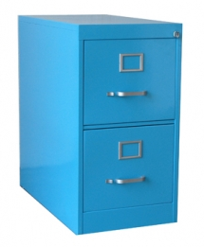
Retain records
Retain records for two years following the date of the election.
Notify elections board if committee contact information changes.

Slide 6

Final audit
Committee status will change to “Closed Pending.”
After elections board completes final audit, status will change to “Closed.”

